Slide 1
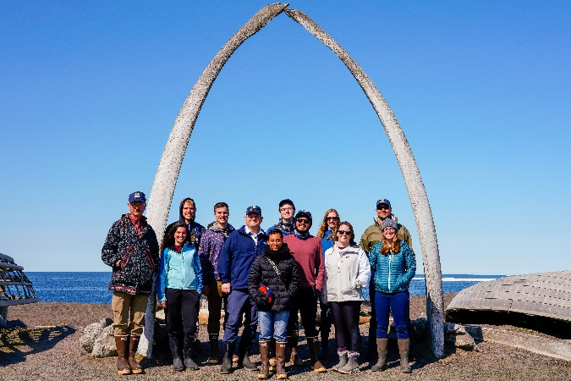
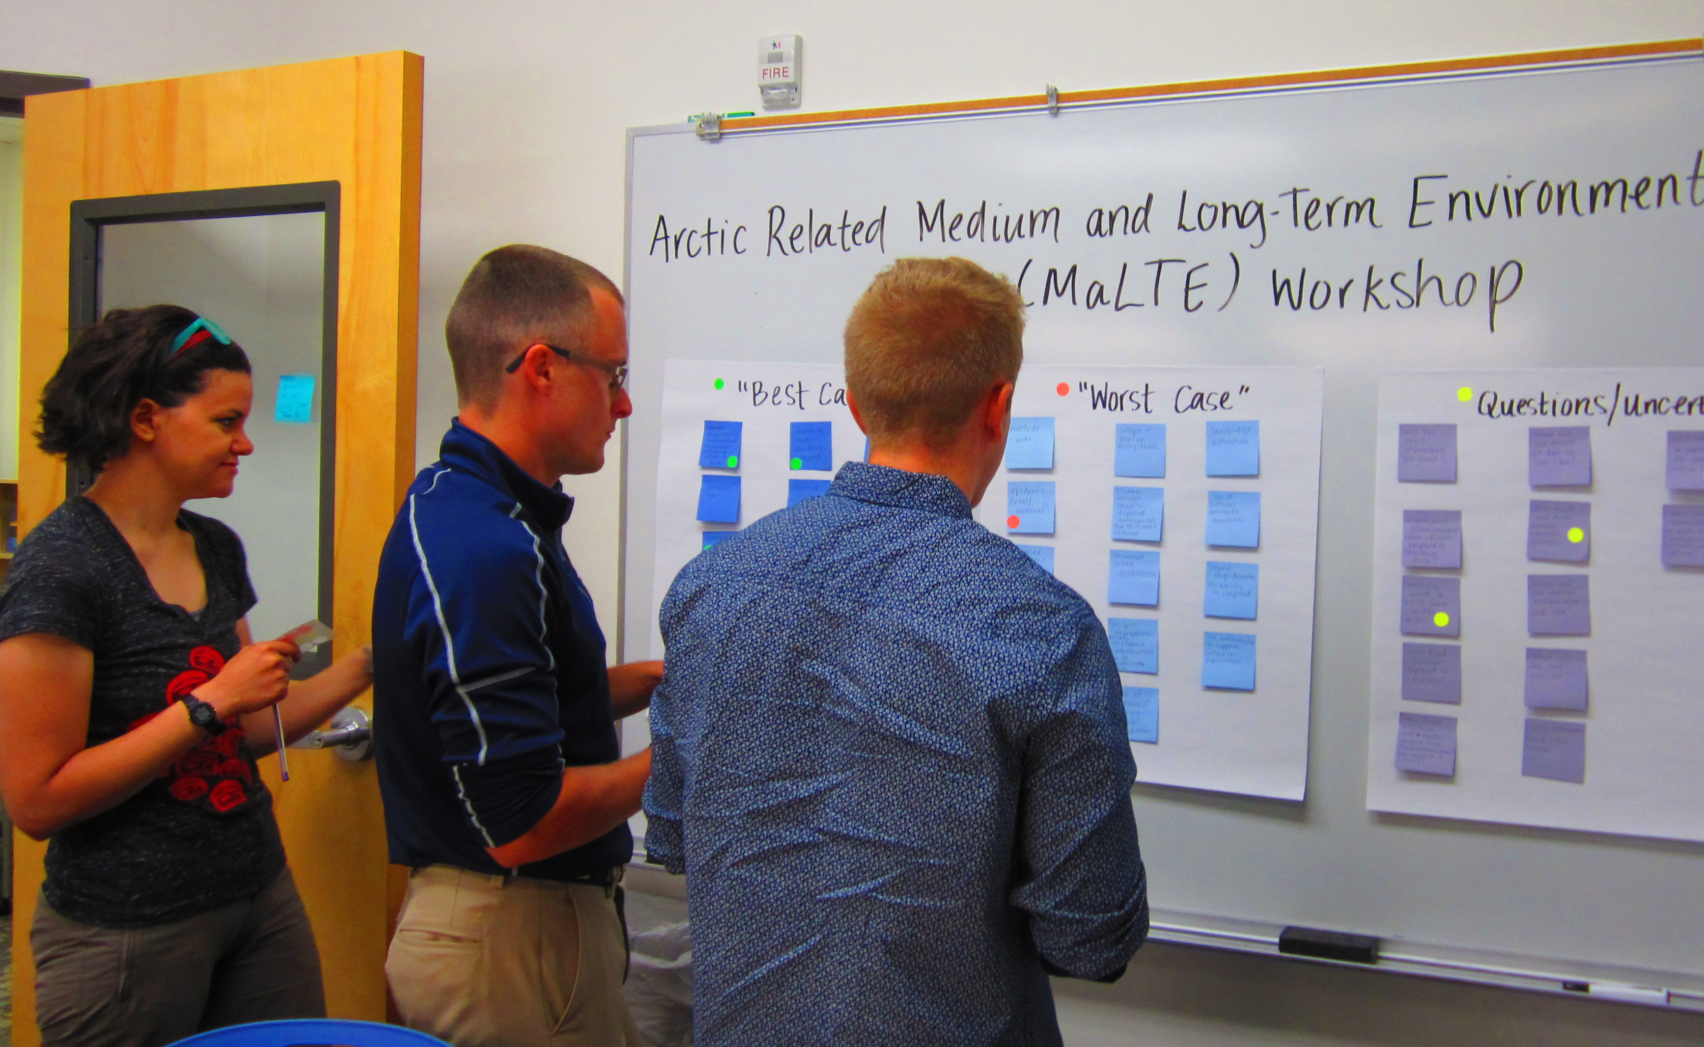
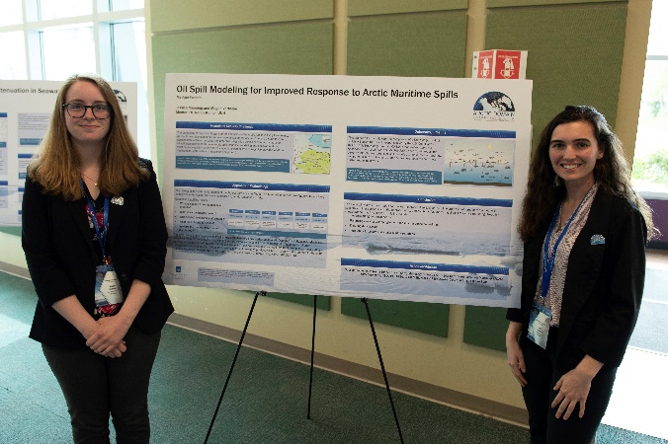
ADAC Program Year 7: Customers & Partners Roundtable
October 7, 2021
ADAC’s Education Programs
Ellee Matthews, ADAC Education & Administrative Manager

Slide 2
ADAC Education Program: Structure
ADAC Program Year 8 1st Customers & Partners Roundtable
ADAC Fellowship Program
Workforce Development (WFD) Fellowship Program
Integrated Minority Serving Institute (MSI)/Arctic Summer Internship Program (ASIP)
The ADAC Education Program is comprised of two major components:

Slide 3
ADAC’s Workforce Development (WFD) Fellowship Program
ADAC Program Year 8 1st Customers & Partners Roundtable

Slide 4
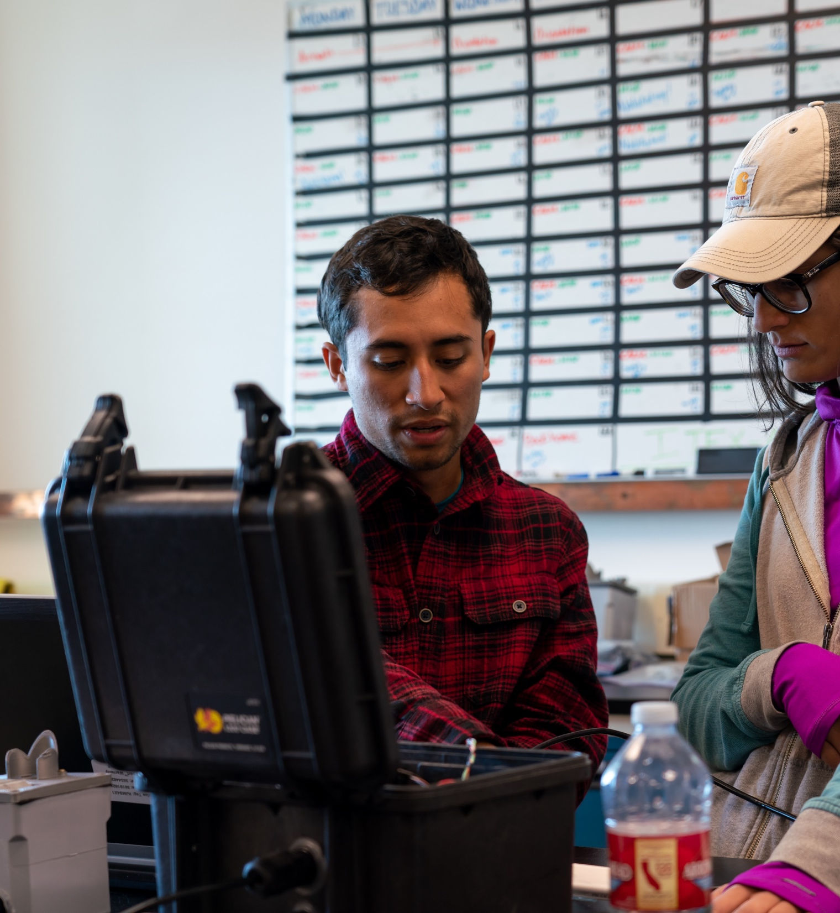
ADAC’s Workforce Development (WFD) Fellowship Program
ADAC Program Year 8 1st Customers & Partners Roundtable
Project Principal Investigator: Ellee Matthews (UAA)
Lead Institution: University of Alaska Anchorage (UAA)
Supporting Team: Jeff Libby and Jason Roe

Slide 5
Workforce Development (WFD) Fellowship Program
ADAC Program Year 7 Annual Meeting 2-3 June 2021
ADAC’s WFD Fellows are funded via a DHS S&T OUP Cooperative Grant
Project Objectives:
Attract the highest caliber undergraduate and graduate students to our education programs.
Nurture and train these students for careers in DHS — related applied fields of science and technology.
Provide students opportunities for direct involvement in DHS operations and embedded research among our DHS collaborators and stakeholders.
Provide education and mentorship to students that leads to timely completion of degrees and fulfilling careers in DHS Enterprise or related fields.
Potential Impact:
Contribute to the growth of highly skilled workforce for Homeland Security agencies.
Contribute to the capability of US Coast Guard operator and in support of USCG missions in the Arctic.
MSI/ASIP Program
Workforce Development(WFD)
Fellowship Program
ADAC Education Program

Slide 6
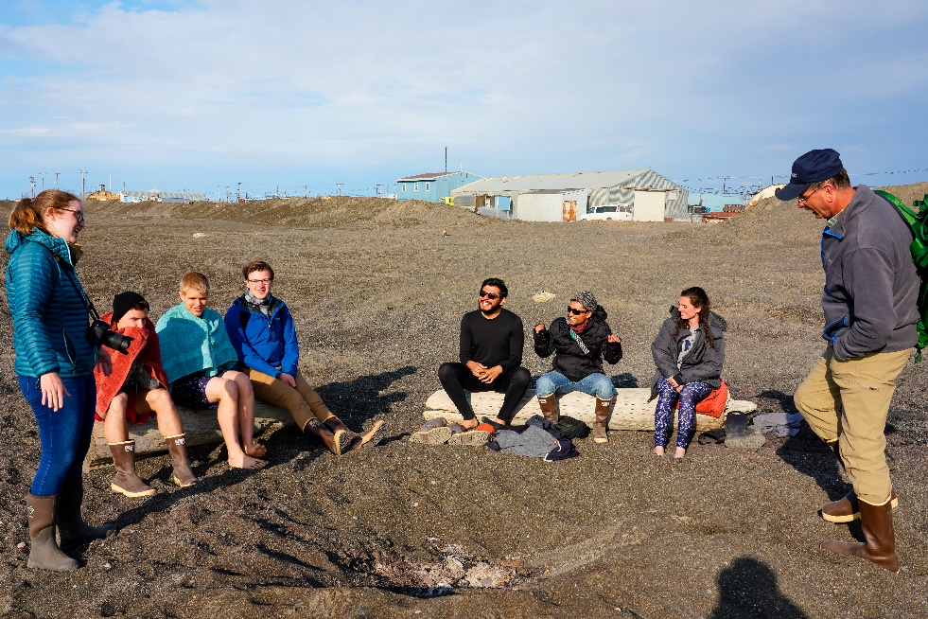
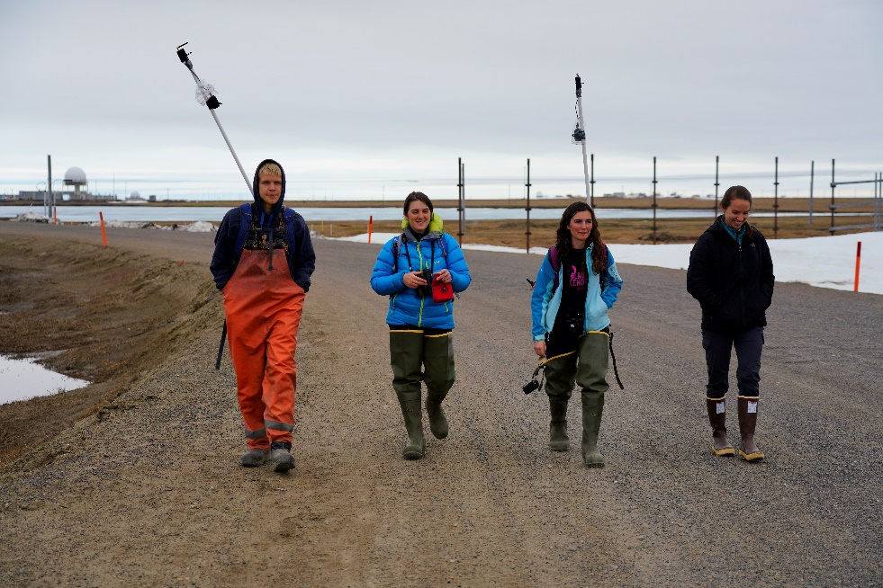
Current Active ADAC Fellows - Program Year 8
ADAC Program Year 8 1st Customers & Partners Roundtable
Arctic Domain Awareness Center - Program Year 8 Overview of all Current Supported Fellows
 | Univ. of Alaska Anchorage, AK (UAA) | Univ. of Alaska, Fairbanks (UAF) | Univ. of Texas at El Paso, TX (UTEP)* | Univ. of New Hampshire, NH (UNH) | Univ. of New Orleans, LA (UNO)
Undergrad | 2 | 1 | 1 | 1 | 0
Graduate | 0 | 0 | 0 | 0 | 1
Total | 2 | 1 | 1 | 1 | 1
Total Overall Active Fellows: | 6
* An accredited MSI institution

Slide 7
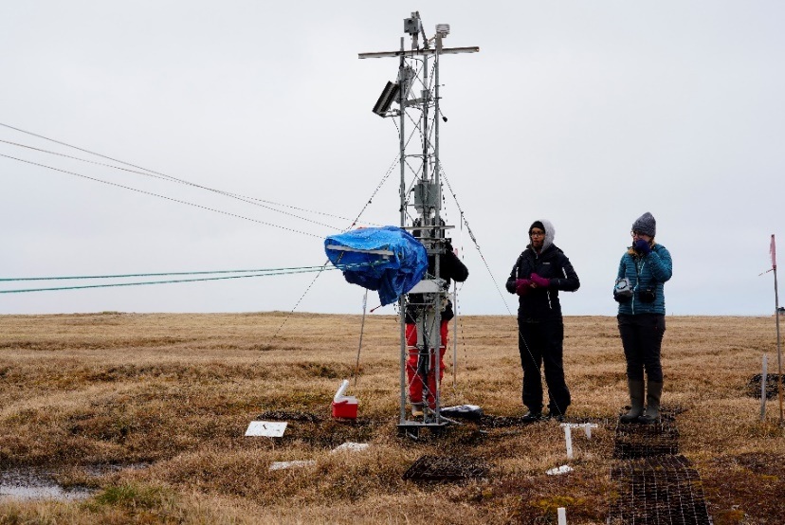
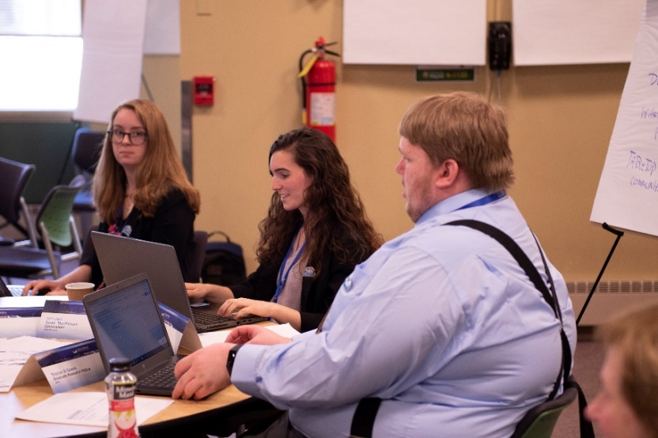
Progress: Outreach, Exchange, & Activities
ADAC Program Year 8 1st Customers & Partners Roundtable
Student Exchange Activities:
  Past:
    Weekly ADAC All-Hands Meetings
    September 2021: ADAC’s Infrastructure Environmental Risk Index Project Workshop
  Upcoming:
    October 2021: ADAC’s Arctic & Alaska Maritime Communications and Connectivity Analysis Project Workshop
    November 2021: Maritime Risk Symposium
Center-Specific Projects & Activities:
    Past:
      August 2021: ADAC Onboarding and Fellowship Introductory Meeting
      September 2021: Completion of first drafts of Fall semester 2021 student work plans
    Current:
      Attendance at monthly mentoring meetings with ADAC Leadership Team
      Attendance at weekly meetings with mentors and project principal investigators

Slide 8
Progress: Current Student Research Engagement in ADAC Projects
ADAC Program Year 8 1st Customers & Partners Roundtable
Project Name | Fellow(s) on Project | University
Arctic Vessel Monitoring/Geofencing | Undergraduate Fellow, Benjamin Good | UAA
Arctic Oil Spill Modeling Strategies | Undergraduate Fellow, Tori Sweet | UNH
Arctic Mussels | Graduate Fellow, Katherine Humpal | UNO
Arctic Infrastructure and Environmental Risk Index | Undergraduate Fellows, Brenda Almanza and Caitlynn Hanna | UTEP, UAF
Arctic and Alaska Maritime Communications and Connectivity Analysis Project | Undergraduate Fellow, Talha Ali | UAA

Slide 9
ADAC Summer 2021 Onboarding Program
ADAC Program Year 8 1st Customers & Partners Roundtable

Slide 10
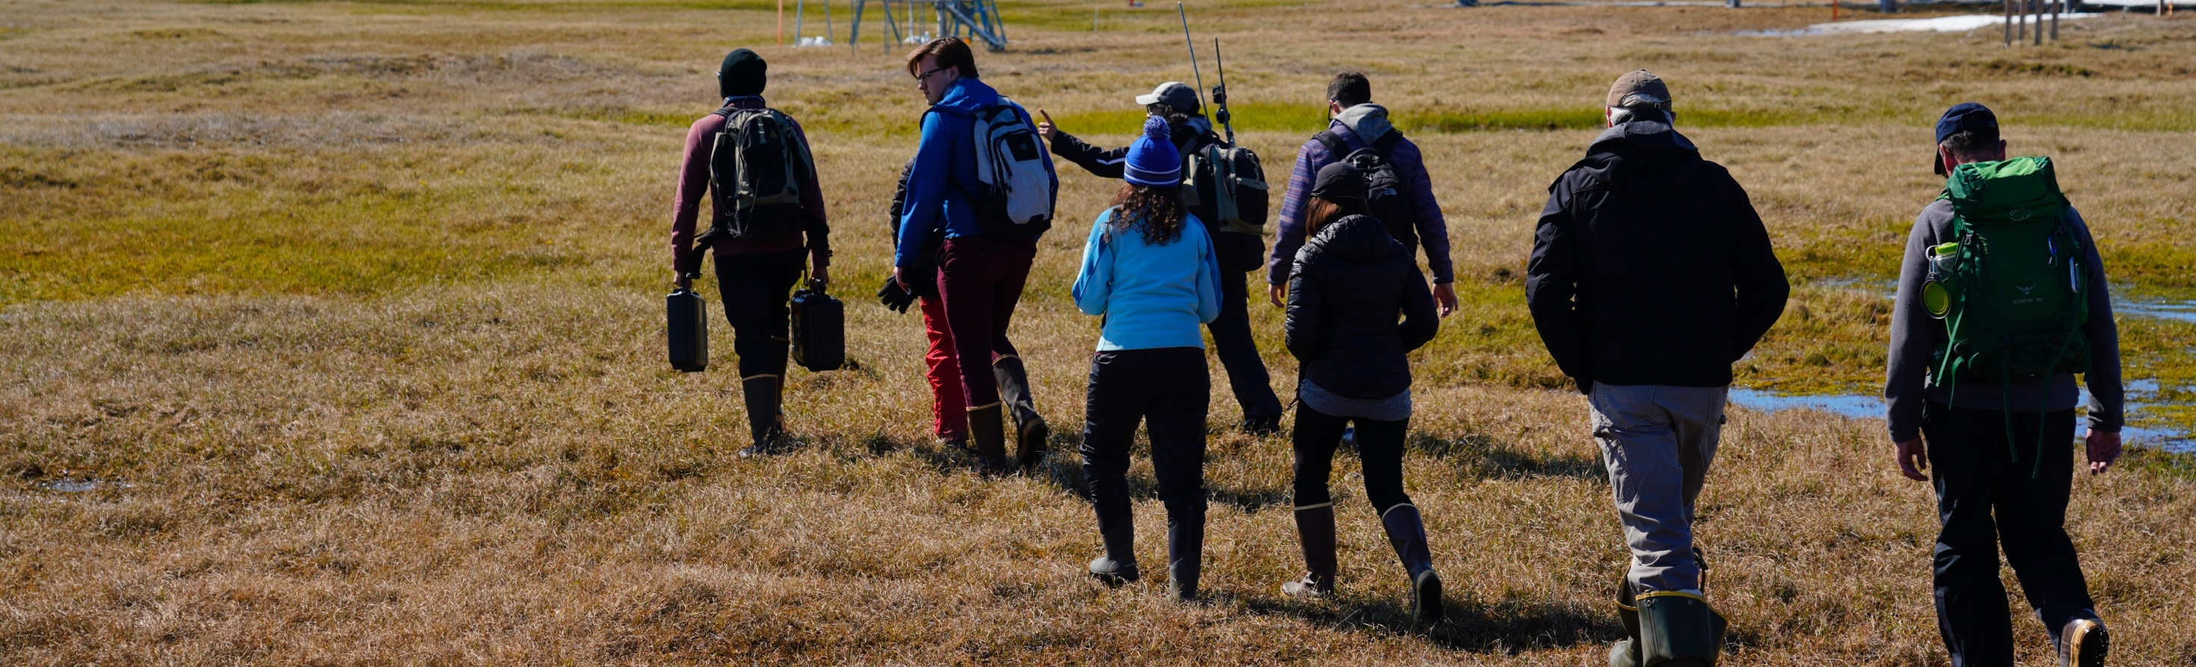
ADAC’s Summer 2021 Fellows Onboarding Program
ADAC Program Year 8 1st Customers & Partners Roundtable
Project Principal Investigator: Ellee Matthews (UAA)
Lead Institution: University of Alaska Anchorage (UAA)
Supporting Team: Jeff Libby and Jason “Olaf” Roe

Slide 11
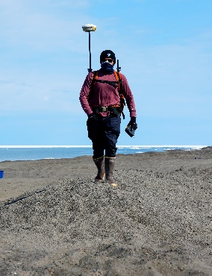
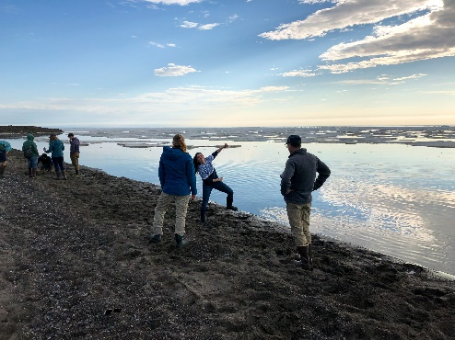
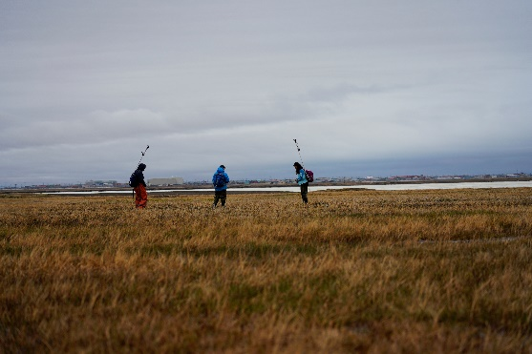
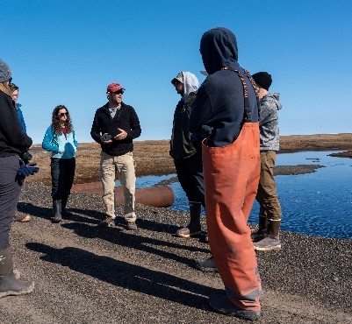
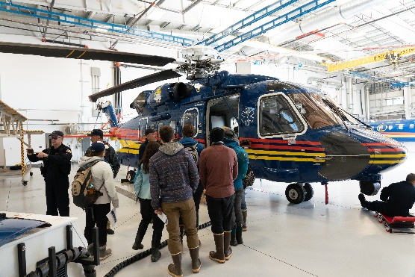
MSI/ASIP Onboarding Program 2021: Overview
ADAC Program Year 8 1st Customers & Partners Roundtable
Program Leadership: Ellee Matthews
Dates: July 1 – August 20
Delivery: Virtual (Microsoft Teams, Zoom, and Google Calendar)
Students: 4

Slide 12
MSI/ASIP Onboarding Program 2021: Components & Objectives
ADAC Program Year 8 1st Customers & Partners Roundtable
Program Components
Program Objectives
Guest Presentations
Independent Projects and Assignments
Onboarding Program
Workforce and Professional Development Lectures
To prepare students to enter the academic research field from an ADAC fellow perspective, while providing the students with a foundational understanding of the Arctic domain.
To utilize an interdisciplinary and holistic approach to teach students of the interconnected nature of the Arctic domain.
To introduce students to the Homeland Security Enterprise, the role of the USCG in this Enterprise, as well as in the Arctic more broadly.
To prepare students for their role as academic fellows during the academic year, 2021/2022 with ADAC research teams.

Slide 13
New ADAC Fellows Program Year 8 1st Quarter
ADAC Program Year 8 1st Customers & Partners Roundtable
Student | University | Degree | ADAC Project
Summer/Fall 2021
Tori Sweet | UNH | B.S. Environmental Engineering | Arctic Maritime Oil Spill Modeling with Dr. Nancy Kinner
Caitlynn Hanna | UAF | B.S. Mechanical Engineering | Arctic Infrastructure and Environmental Change Risk Index with Ms. Kelsey Frazier
Benjamin Good | UAA | B.S. Computer Science | Arctic Vessel Geofencing with Dr. Shawn Butler
Talha Ali | UAA | B.S. Computer Science | Arctic and Alaska Maritime Communications and Connectivity Analysis with Mr. Jason Roe

Slide 14

In Summary…
In ADAC’s Program Year 8 1st Quarter, 4 new students, and 2 returning fellows, have joined ADAC’s 2021 Summer Onboarding Program to pursue an ADAC Fellowship for the 2021/2022 academic year. .
Career options and interest have been looked at on individual basis, and mentoring by ADAC staff has been tailored to assist fellowship graduates to transition to Homeland Security Enterprise related employment.

Slide 15
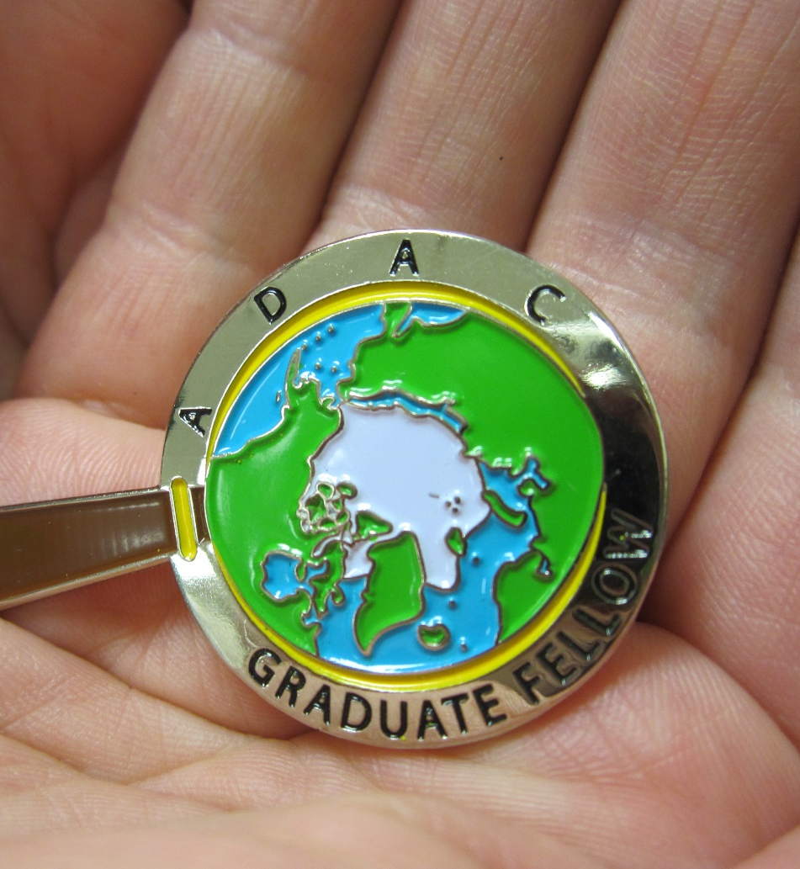
Ready for questions…
ADAC Program Year 8 1st Customers & Partners Roundtable
Feedback?
What are we missing?
What can we improve?
Who should we connect with to improve our success?
Notes:
Thank you for the gift of your time and attention.

